Slide 1
Software Engineering Methodology
(BCSC0057)
Topic: Data Flow Diagrams
Lecture No.
Ruchi Agrawal
Assistant Professor, CEA deptt.
GLA UNIVERSITY Mathura, Uttar Pradesh, India

Slide 2
Requirements Analysis
We analyze, refine and scrutinize requirements to make consistent & unambiguous requirements.
Steps
Draw the context Diagram
Develop prototype (optional)
Model the Requirements
Level 0: DFD
Level 1: DFD
Level 2: DFD
Finalize the Requirements
Requirements Analysis Steps

Slide 3
Context Diagram
Administrator
Marks Entry Operator
Subject Information Entry
Student Information Entry
Marks Entry
Result Management System
Student Information Reports generated
Mark sheet generated
Student performance Reports generated

Slide 4
Data Flow Diagrams
Data Flow Diagrams
DFD show the flow of data through the system.
--All names should be unique
-- It is not a flow chart
-- Suppress logical decisions
-- Defer error conditions & handling until the end of the analysis
Symbol Name Function
Data Flow Connect process
Perform some transformation of its input data to yield output data.
Process

Slide 5
Data Flow Diagrams
Symbo
Name
Source or sink
Function
A source of system inputs or sink of system outputs
A repository of data, the arrowhead indicate net input and net outputs
to store
Data Store
Leveling
DFD represent a system or software at any level of abstraction.
A level 0 DFD is called fundamental system model or context model represents entire software element as a single bubble with input and output data indicating by incoming & outgoing arrows.

Slide 6
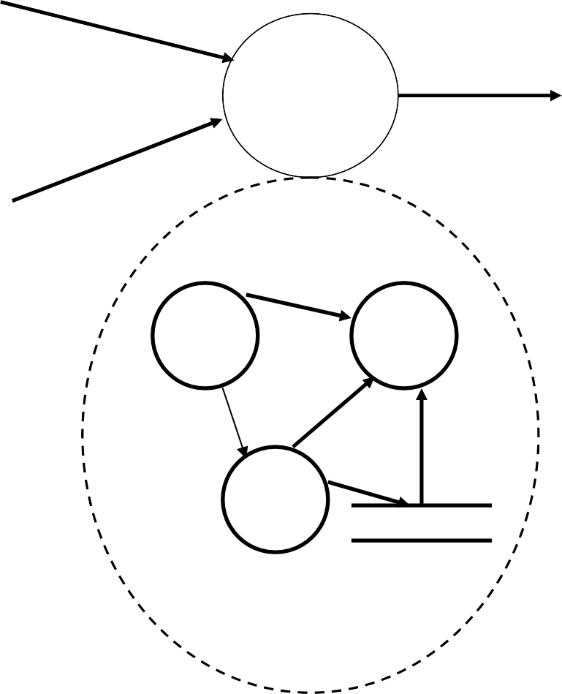
Requirements Analysis
I1
A
O3
I2
I1
O3
I2

Slide 7
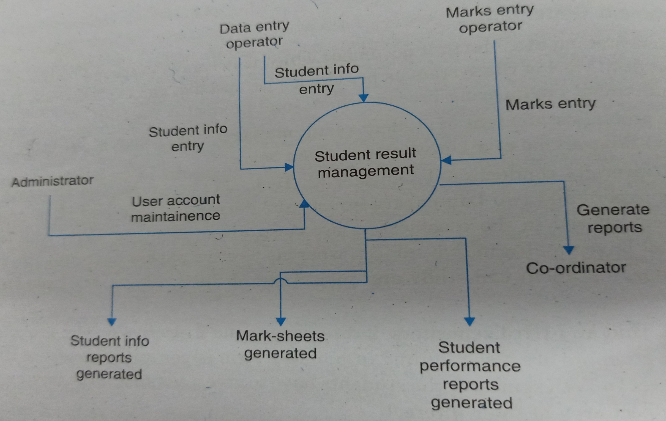
Level-0 :DFD of Result Management System for a M.tech Program

Slide 8
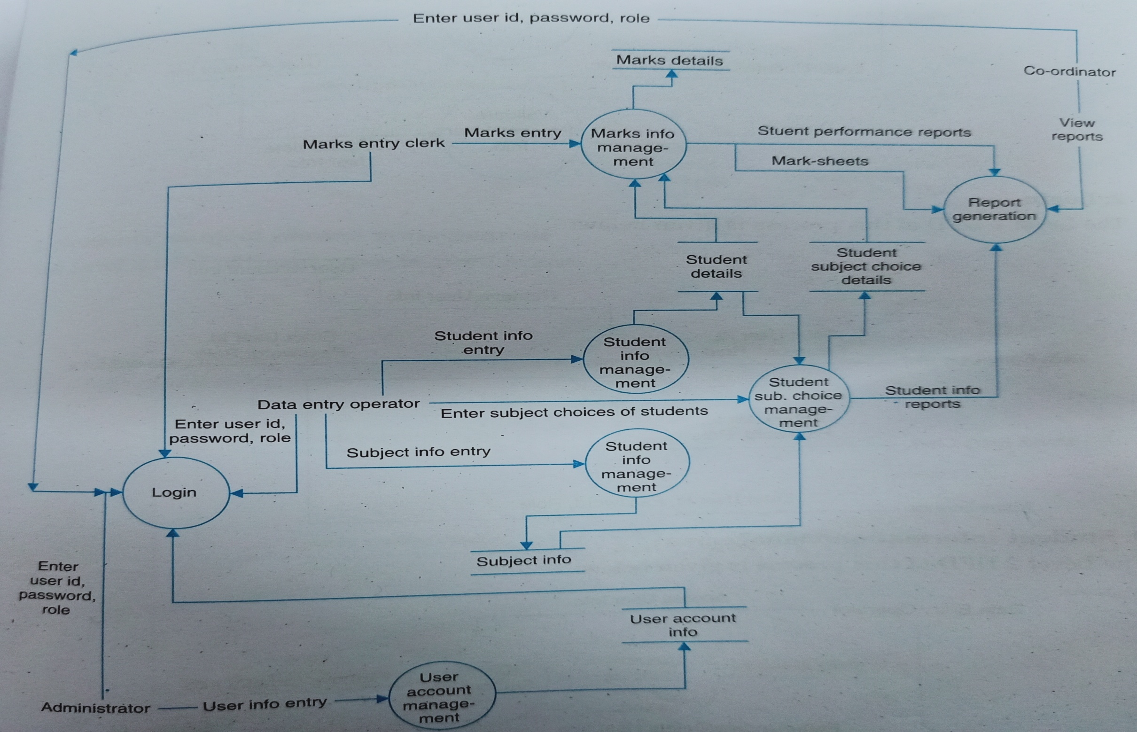
Level-1 DFD of Result Management System for a M.tech Program

Slide 9
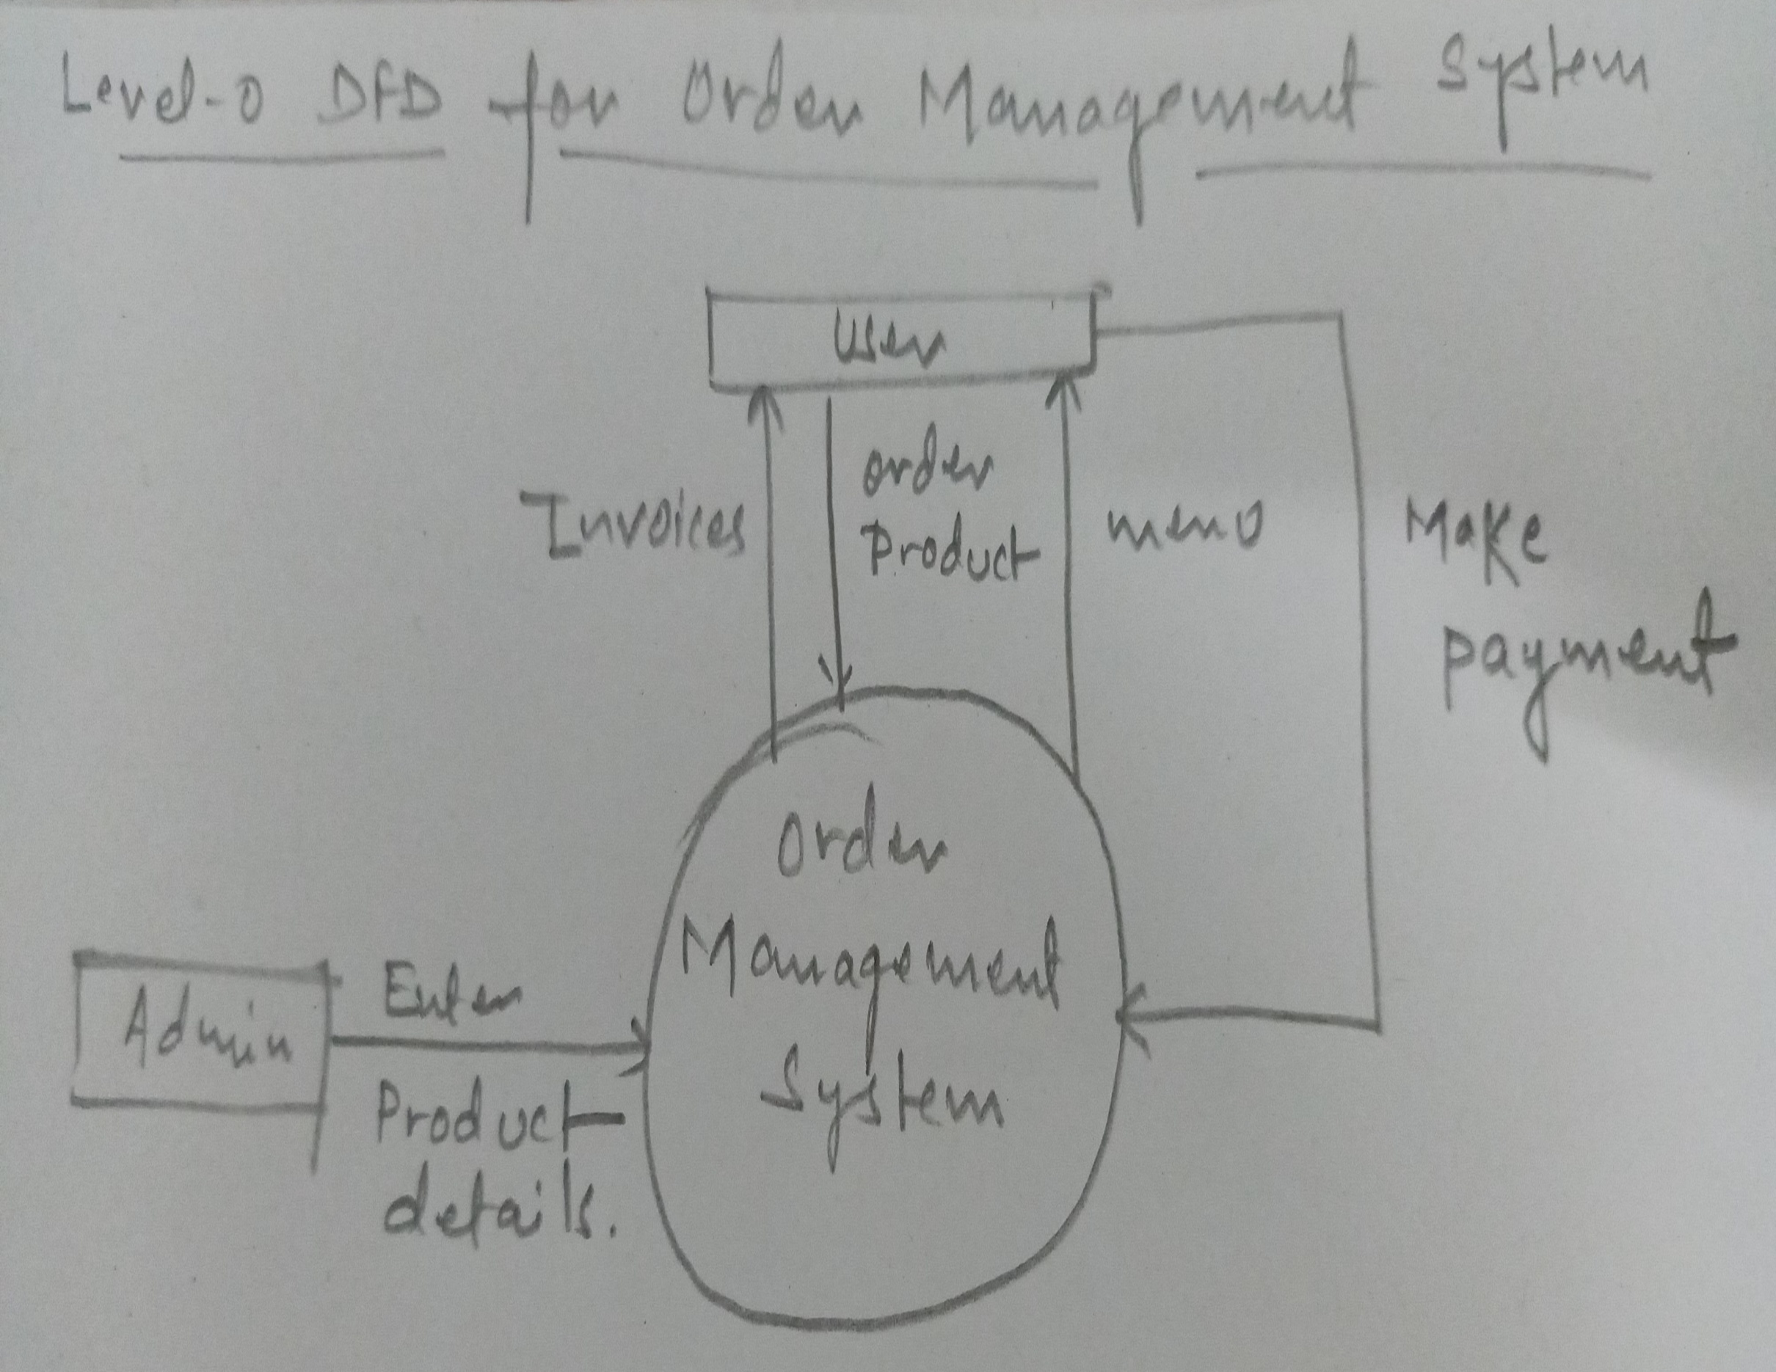

Slide 10
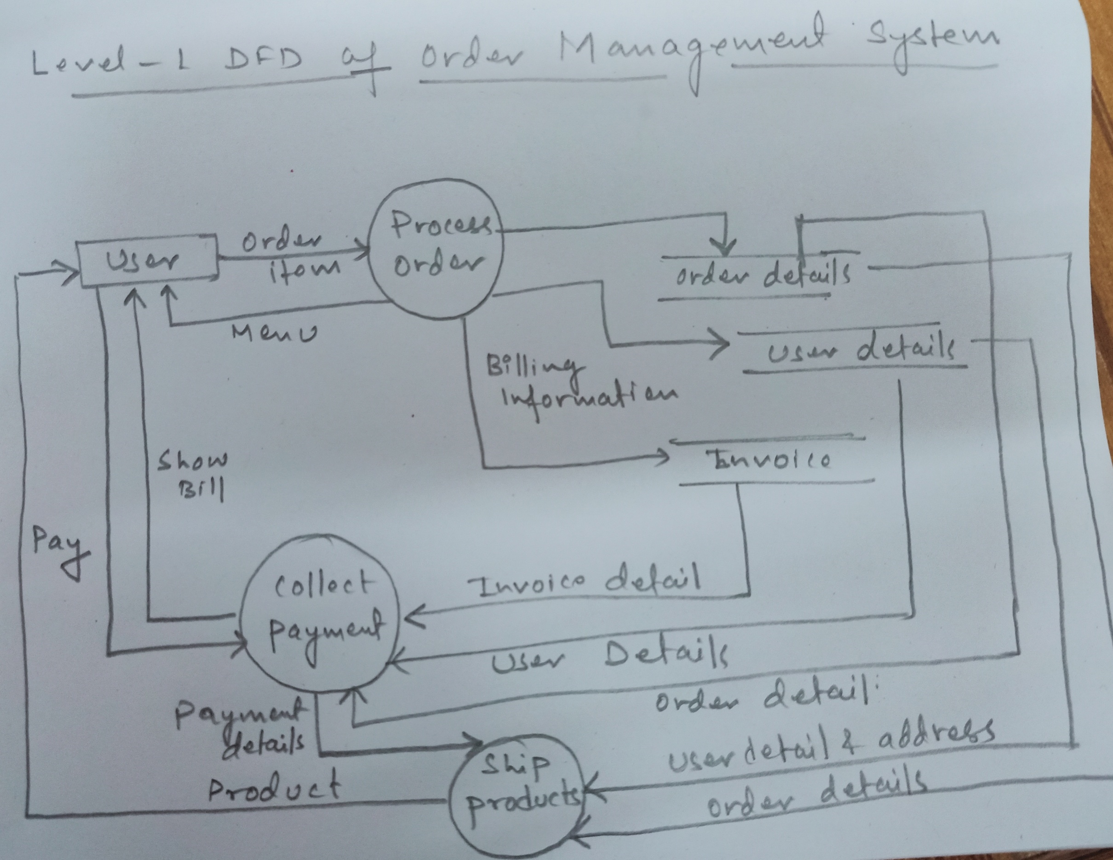

Slide 11
Data Dictionaries
DFD DD
Data Dictionaries are simply repositories to store information about all data items defined in DFD.
Includes :
Name of data item
Aliases (other names for items) Description/Purpose
Related data items
Range of values Data flows
Data structure definition

Slide 12
References
K.K. Aggarwal and Yogesh Singh, “Software Engineering”, Third Ed., New Age International (P) Limited Publishers. (2009).
Pankaj Jalote, “An Integrated Approach to Software Engineering”, Third Ed., Narose Publishing House, (2008).
Rajib Mall, “Fundamentals of Software Engineering”, Fourth Ed., PHI Learning Private Limited, (2016).
Roger S. Pressman, “Software Engineering: A Practitioner’s Approach”, Fifth Ed., McGraw–Hill Higher Education, (2001).

Slide 13
Thank You

